Slide 1
DS/AI on Metaverse
WF DSAI Summer Camp 2023

Slide 2
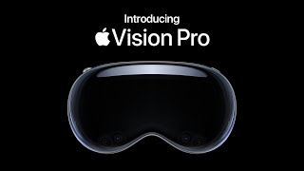
https://www.youtube.com/watch?v=TX9qSaGXFyg

Slide 3
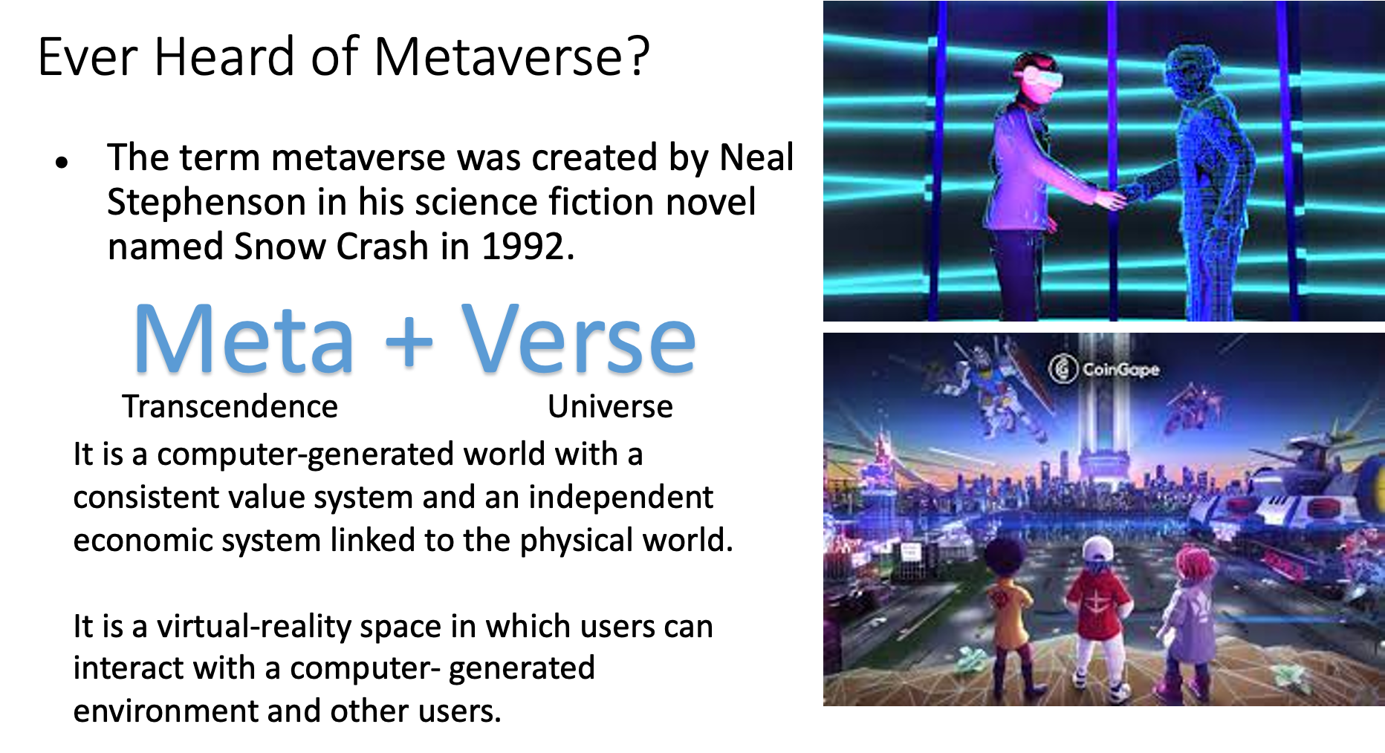

Slide 4
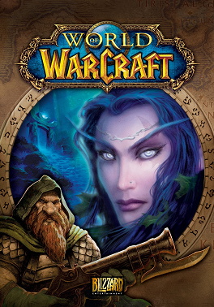
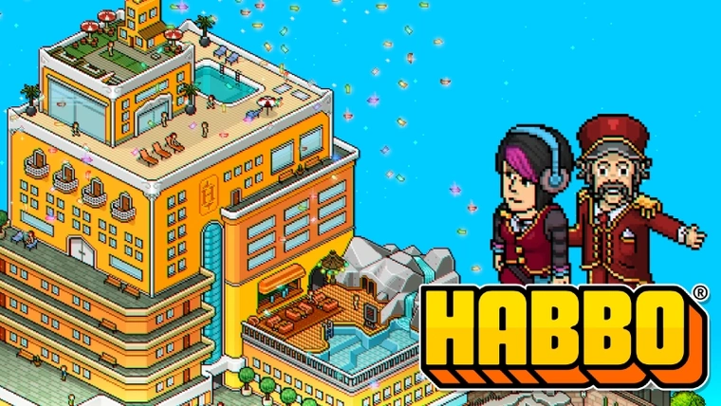
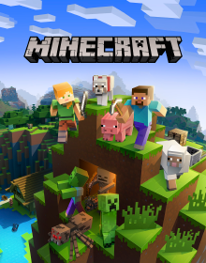
Quiz Time: tell the name of these games
???
???
???
You may already onboard Metaverse!

Slide 5
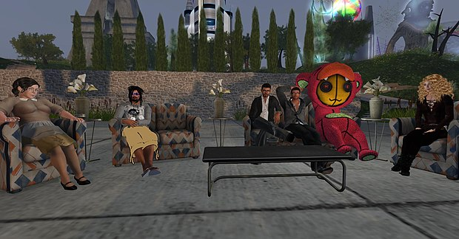
There are more…
Popular games described as part of the metaverse include:
Habbo Hotel, World of Warcraft, Minecraft, Fortnite, VRChat, and game creation platform Roblox which has sine employed significant usage of the term in marketing.
In a January 2022 interview with Wired, Second Life creator Philip Rosedale described metaverses as a three-dimensional Internet that is populated with live people.

Slide 6






Just Game Space or More Values?
Opportunities with Metaverse
Consumer Metaverse:
Enhances the social, entertainment, and wellbeing experiences of individuals
Commercial Metaverse:
Creates next-generation, immersive communication and collaboration between people in a work environment
Industrial Metaverse:
Enables humans and AI to work together to design, build operate, and optimize physical systems using digital technologies

Slide 7
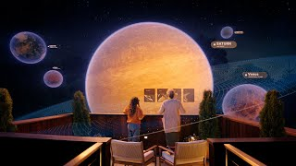
Education in the metaverse
https://www.youtube.com/watch?v=KLOcj5qvOio

Slide 8
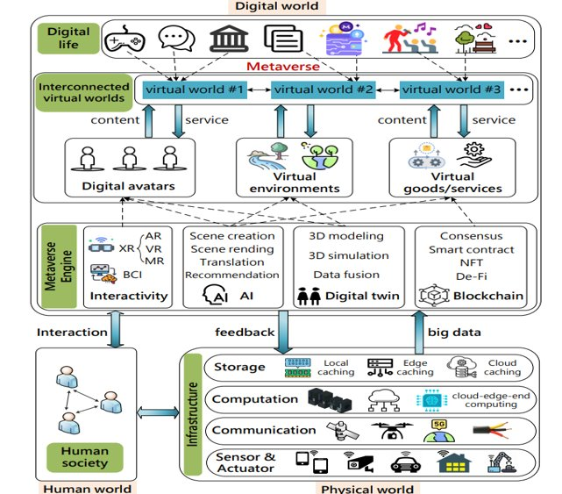
How to Construct Industrial Metaverse?
-Architecture of An Industrial Metaverse
Source:(PDF) A Survey on Metaverse: Fundamentals, Security, and Privacy (researchgate.net)

Slide 9
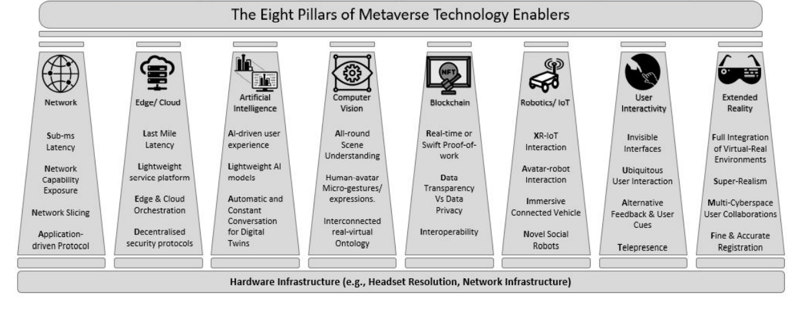
Enabling Technologies of Industrial Metaverse
Source:[PDF] All One Needs to Know about Metaverse: A Complete Survey on Technological Singularity, Virtual Ecosystem, and Research Agenda (researchgate.net)

Slide 10

Industrial Metaverse Demonstration

Slide 11
What is Industrial Metaverse?
Enables humans and AI to work together to design, build operate, and optimize physical systems using digital technologies.
The industrial metaverse can create a relationship between physical devices and the digital world.
The industrial metaverse would utilize the digital twin to achieve the link between the physical devices and the digital world.
The digital twin is perhaps at the heart of the Industrial Metaverse.

Slide 12
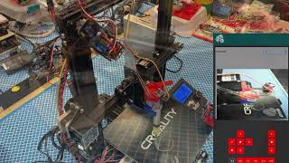
Digital Twin Demonstration

Slide 13
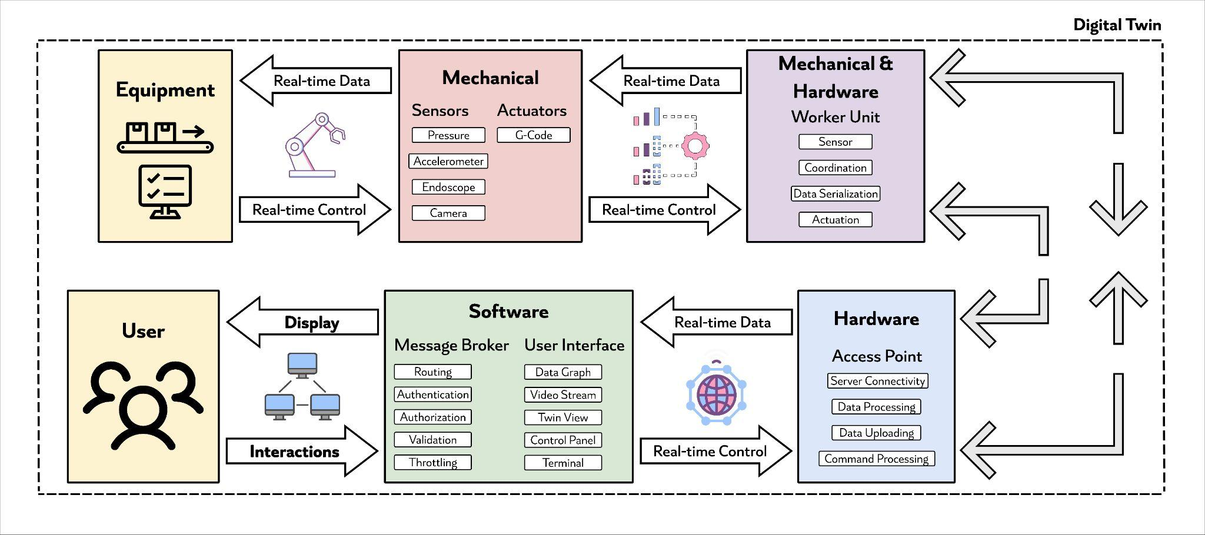
Digital Twin Architecture
Data Science powers the control decision making
Python Coding enables the whole framework

Slide 14
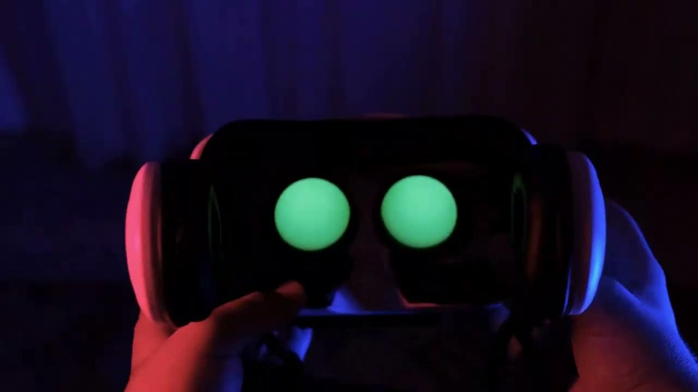
Linkage to Data Analytics/ML?
Add more machine learning capabilities and error correction
Analyze and improve distributed manufacturing processes

Slide 15
Fun Project Showcase: Blender Digital Twin
Overarching Goal: To create a web based VR application which can represent a real world blender in a digital format, interactively and in a way that reflects what is happening to the blender in real life.
Sub-goal 1: Blender Twin
Create a model of a blender in the blender application
Different animations for speed and rotation
Sub-goal 2: Product Twin
Create different effects and animations to represent the product being blended
Different colors for the contents, and textures with blending motions
Sub-goal 3: Web Application
Fetch data from cloud server, and display data in the web application.
Interact with model from web application.

Slide 16
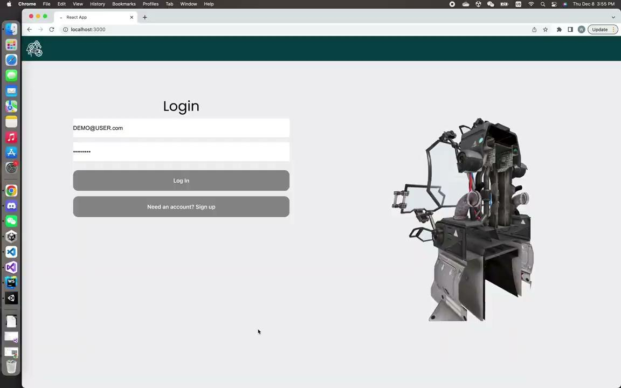
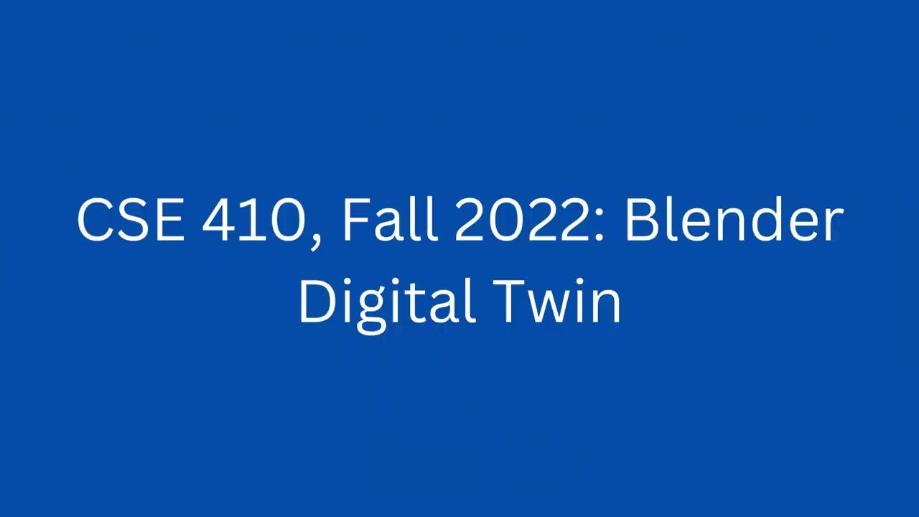
Blender Twin Demonstration
Blender Digital Twin
Blender Physical

Slide 17

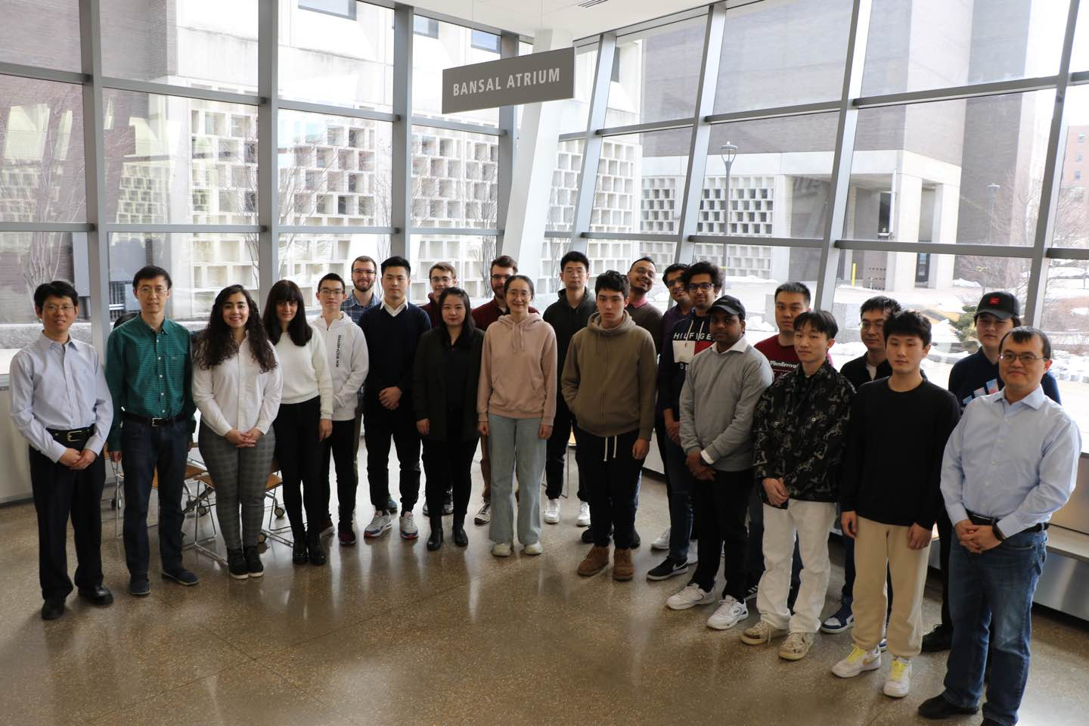


Acknowledge
NSF FM-2134409
multiSTage distRibuted futurE mAnufacturing systeMs

Slide 18

Python
Application
Algorithm
Device
Claim you spot @ Metaverse

Slide 19
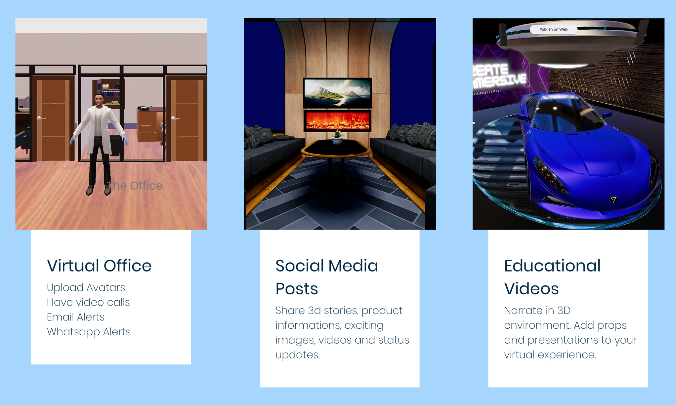
Tools for creating AR/VR
Vizard7 (Window version only): https://www.worldviz.com/vizard-virtual-reality-software
Buildvr (1 month free trial): https://www.gretxp.com/buildvr
Unity (Free student account for 16 yrs+)
…

Slide 20
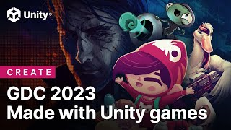
Create your own project on Metaverse
Learning resource: https://learn.unity.com/
Download unity:
https://unity.com/download
Unity student plan:
https://unity.com/products/unity-student
Create the Metaverse
https://learn.unity.com/tutorial/preparing-students-to-create-the-metaverse#
https://www.youtube.com/watch?v=ucalG1dsvL4

Slide 21
Warm Up with Unity
Pre-request
Require Unity Hub installation
After Unity Hub installation, install the subfiles
Register

Slide 22
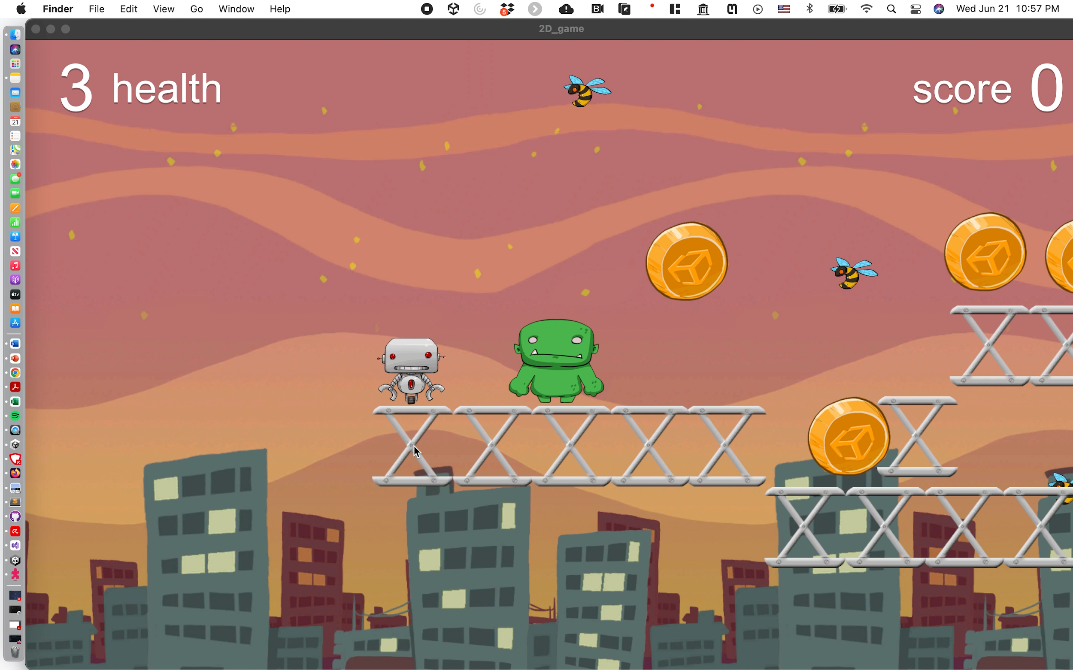
Build a Game on Unity
Instruction: Course Github

